Slide 1
Toolbox Talk
The risks of being impaired by alcohol & other drugs
TOOLBOX TALK 2023

Slide 2
Overview
Impact of substance abuse
Safety risks in driving with substance abuse
Misuse of alcohol and drugs
How alcohol and drugs impact on your driving ability
Consequences of alcohol and drugs
Physical signs of substance abuse
How can a business monitor and address substance abuse in the workplace

Slide 3
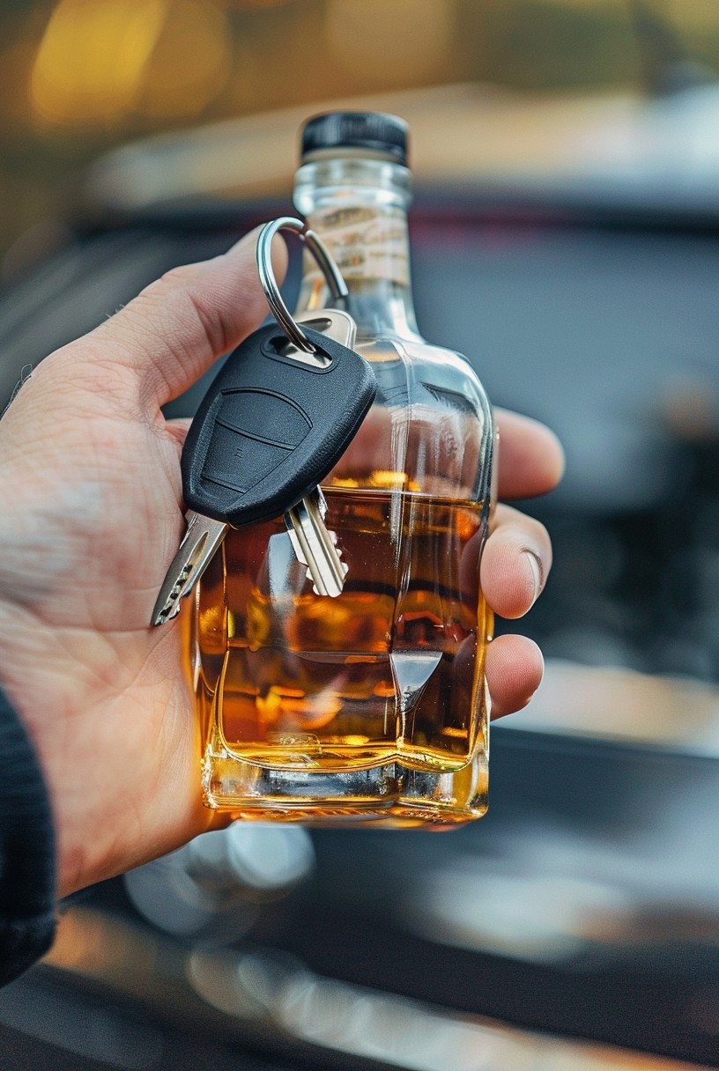
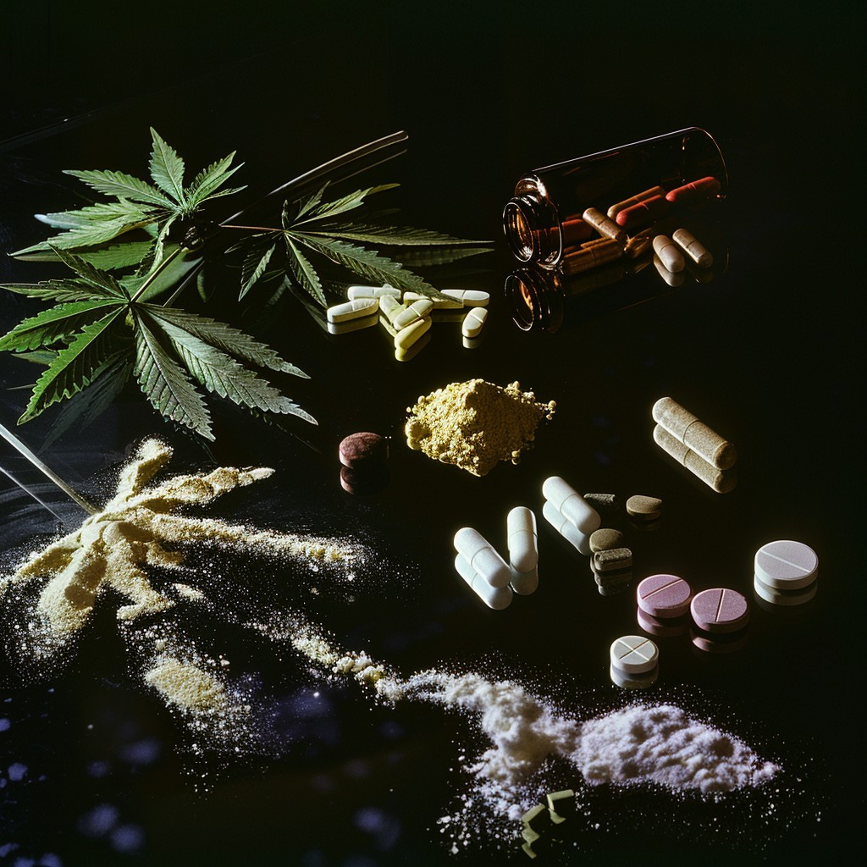
What is substance abuse
involves overuse (often to dangerous levels) of alcohol, tobacco or other drugs.
Substance abuse
can also be called
substance use disorder.

Slide 4
Example of a transport incident
A commercial vehicle driver travelling south from Marree died when his 16-tonne truck left the road before coming to a stop in a dry riverbed. The driver is understood to have been awake for a long period and it is believed he may have fallen asleep while driving. The forensic pathologist’s report found evidence of alcohol and prescription medicine that contained a stimulant. The driver’s journey was in the early hours of the morning, when fatigue is most likely to take effect. There was no flexible scheduling practice in place at work to enable him to sleep.
Notes:
Facilitator:
Read to attendees and ask the following question:
What factors contributed to the incident?
Get input from your group and then go to next slide

Slide 5
Answers
What factors contributed to the incident?
Prescription drugs
Lack of sleep
Fatigue
Loss of concentration
Insufficient recovery times between shifts
Lack of information on use of alcohol and other drugs
Notes:
Facilitator:
Note there can be other answers

Slide 6
Manage Safety Risks
As a driver, it is important to:
prioritise not only ensure your safety and your passengers, but the safety of other road users and the general public.
Crucial to both businesses and employees must prioritise the safety of their transport activities.
For both driver and employee fitness to work
effective control of alcohol and drugs – fitness plan.
Notes:
As a driver, it is important to prioritise not only ensure your safety and that of your passengers, but also the safety of other road users and the general public.
It is crucial both businesses and their employees must prioritise the safety of their transport activities.
For both driver and employee fitness to work, the effective control of alcohol and other drugs should form the basis of any fitness plan.
If alcohol or drugs are found to be the cause of a vehicle crash or any other safety related incident that can result in bodily harm, eg: disability, death and legal consequences.

Slide 7
Manage Safety Risks
A business may suffer harm to their reputation if alcohol or drugs are determined to be a factor of an accident or incident, eg:
heavy vehicle accident (COR)
forklift accident in the warehouse (WHS)
Proactive measures to address safety risks relate to:
Regulations and Laws, ie:
Chain of Responsibility
Workplace Health & Safety
Notes:
A business may suffer harm to their reputation if alcohol or other drugs are determined to be factors in a heavy vehicle accident or any other safety incidents eg: a forklift accident in a warehouse. However, effective and ongoing management of these safety risks can help a business become a contractor of choice.
Taking proactive measures to address safety risks will help all parties in the Chain of Responsibility (COR) and Workplace Health & Safety, in ensuring the safety of employees and the public while avoiding regulatory penalties.

Slide 8
What contributes to misuse
Alcohol and other drug relations problems can occur in any workplace. Some factors are:
grief
family and relationship problems
health concerns
gambling
financial problems
harassment or bullying
tight deadlines and unrealistic performance targets
long and/or irregular working hours

Slide 9
Issue of alcohol and drugs
The use of alcohol and other substances (including prescribed & OTC medications) can hinder an individual's capacity to work safely, posing significant safety hazards to themselves, co-workers, fellow road users, and the public at large.
A heavy vehicle driver who is impaired can also affect a business's capacity to fulfill its legal responsibilities under the HVNL and other regulations, including workplace health and safety laws.
Notes:
The use of alcohol and other substances (including prescribed and over-the-counter medications) can hinder an individual's capacity to work safely, posing significant safety hazards to themselves, co-workers, fellow road users, and the public at large.
A heavy vehicle driver who is impaired can also affect a business's capacity to fulfill its legal responsibilities under the Heavy Vehicle National Law (HVNL) and other regulations, including workplace health and safety laws.

Slide 10
Issue of alcohol and drugs
Are you aware that being impaired by alcohol and drugs can be categorised as a hazard and poses a potential risk.
The potential hazards and risks:
Risk to the safety and wellbeing of co-works and the public
Risks of damage to infrastructure (business & public)
Financial risks to a business due to disruptions caused by an employee
Notes:
Are you aware that being impaired by alcohol and drugs can be categorised as a hazard and poses a potential risk.
The potential risks resulting from these hazards may include:
risks to the safety and wellbeing of co-workers and the public
risks of damage to infrastructure (including business owned and public infrastructure)
financial risks due to disruptions in a business operations caused by an employee

Slide 11
Issue of alcohol and drugs
Did you know in Australia that:
drink driving is responsible for approx. 30% of fatalities
marijuana is the second most common drug found in road fatalities
Notes:
Did you know that in Australia, drink driving is responsible for approx. 30% of fatalities and marijuana is the second most common drug found in road fatalities

Slide 12
Substance Abuse Implications
Consumption of alcohol & drugs impair a person’s ability to:
Drive safely
Leads to decreased co-ordination
slow reaction times
Impaired judgement
Increased risk of accidents on the road
Refrain from driving the influence to ensure safety of oneself and others on the road.
Notes:
The consumption of alcohol and drugs can significantly impair an individual's ability to drive safely, leading to decreased coordination, slower reaction times, impaired judgment, and an increased risk of accidents on the road. It is crucial to refrain from driving under the influence of alcohol and drugs to ensure the safety of oneself and others on the road.
Driving is a complex task which depends on vision, decision making, reaction time, coordination, judgement and divided attention. Alcohol and many prescription drugs and over the counter medications can adversely affect such skills impairing driving ability and placing you and others on the road at risk of accidents.
The issue with impairment is you feel fine driving in a straight line, but when an unexpected event occurs and you suddenly must respond, your reflexes are slowed down.
It is crucial to refrain from driving under the influence of alcohol and drugs to ensure the safety of oneself and others on the road.

Slide 13
Substance abuse consequences
Impairment from alcohol or drug use can cause changes in body and mind.
Negative impacts whilst driving:
impaired co-ordination
impaired judgement, thinking and decision making
reduced reaction times – decrease motor co-ordination and sensory perception
Notes:
Impairment from alcohol or drug substance use (being “drunk”, “stoned”, “high” or “buzzed”) can cause changes in the body and mind. The negative impacts of driving whilst under the influence of alcohol and drugs are:
impaired co-ordination
impaired judgement, thinking and decision making
reduced reaction times – decrease motor co-ordination and sensory perception
psychological or stress related effects, such as mood swings and personality changes
increased risk of accidents
legal consequences
potential harm to oneself and others on the road

Slide 14
Substance abuse consequences
psychological or stress related effects, such as mood swings and personality changes
increased risk of accidents
legal consequences
potential harm to oneself and others on the road
Notes:
Impairment from alcohol or drug substance use (being “drunk”, “stoned”, “high” or “buzzed”) can cause changes in the body and mind. The negative impacts of driving whilst under the influence of alcohol and drugs are:
impaired co-ordination
impaired judgement, thinking and decision making
reduced reaction times – decrease motor co-ordination and sensory perception
psychological or stress related effects, such as mood swings and personality changes
increased risk of accidents
legal consequences
potential harm to oneself and others on the road

Slide 15
Substance abuse consequences
Blood Alcohol Concentration (BAC) is a measure of grams of alcohol in the body per 100 millilitres of blood. Australia has strict laws around driving under the influence of alcohol.
Note: Each state and territory in Australia have a Driver’s legal BAC limit for heavy vehicle drivers.
Austroads – Appendix 4 Driver’s legal BAC limits
Notes:
Impairment from alcohol or drug substance use (being “drunk”, “stoned”, “high” or “buzzed”) can cause changes in the body and mind. The negative impacts of driving whilst under the influence of alcohol and drugs are:
impaired co-ordination
impaired judgement, thinking and decision making
reduced reaction times – decrease motor co-ordination and sensory perception
psychological or stress related effects, such as mood swings and personality changes
increased risk of accidents
legal consequences
potential harm to oneself and others on the road
Blood Alcohol Concentration (BAC) is a measure of grams of alcohol in the body per 100 millilitres of blood. Australia has strict laws around driving under the influence of alcohol.
Note: Each state and territory in Australia have a Driver’s legal BAC limit for heavy vehicle drivers, please check your relevant state for information or see link below and read Appendix 4. (link embedded in presentation)
https://austroads.com.au/publications/assessing-fitness-to-drive/ap-g56/drivers-legal-bac-limits

Slide 16
Substance abuse consequences
Alcohol and drugs impair the mental capability of a person and therefore effect their driving ability.
Professional drivers it is illegal to drive a vehicle while impaired by drugs, including prescription drugs and OTC medicines.
Marijuana
Evidence shows marijuana use can increase a motor vehicle crash
Impairs driving performance, cognitive functions and increase risk of crash
Notes:
In many studies, it has been found that there is an association between the use of alcohol and other drugs and crashes. Alcohol and drugs impair the mental capacity of a human being and therefore effect their driving ability.
For professional drivers it is illegal to drive a vehicle while impaired by drugs, which includes prescription and over the-counter medicines
Side effects of prescription medication include drowsiness, shakiness, blurry vision, slower reaction times, poor co-ordination, confusion and difficulties to concentrate.
It is estimate 1 in 4 Australian drivers ignore medication labels.
There is evidence of the statistical association between marijuana use and increased motor vehicle crash risk. Its use has consistently been found that impair driving performance, cognitive functions, and increase the risk of a crash, to the point of “moderately diminish virtually every driving-related capacity”. Even when prescribed by a GP, medicinal Marijuana can impair driving, and driving under its influence is an offence.

Slide 17
Prescription drugs side effects
Side effects of prescription medical and OTC medication are:
Drowsiness
Shakiness
Blurry vision
Slower reaction times
Poor co-ordination
Confusion and difficulty to concentrate
It is estimate 1 in 4 Australian drivers ignore medication labels

Slide 18
Business’s COR duty
Businesses who undertake transport activities have a duty of care under Chain of Responsibility and should conduct a risk assessment to evaluate potential risks related to impaired workers.
They must:
Understand and support final risk assessment and put necessary controls in place to reduce risks
Adequate financial, human and other resources to implement these risks controls
Actively engage in monitoring and evaluation efficiency of controls and encourage continued safe business practices
Notes:
Businesses who undertake transport activities, as an employer or executive in the Chain of Responsibility, should conduct a risk assessment to evaluate the potential risks related to impaired workers.
Employers and executives should understand and support the final risk assessment, determining necessary controls to reduce those risks. Executives must ensure that the business has adequate financial, human, and other resources to implement these risk controls. They should also be actively engaged in monitoring activities to evaluate the ongoing efficiency of the controls and encourage the continuous enhancement of safe business practices.

Slide 19
Everyone duty
It is the duty of employers and executives to ensure and oversee employees to prevent impairment by alcohol and drugs, which could jeopardise their safety or that of others
As an employee you are responsible for your own safety as well as that of your co-workers and any other individuals
Notes:
It is the duty of employers and executives to ensure and oversee employees to prevent impairment by alcohol and drugs, which could jeopardise their safety or that of others.
As an employee you are responsible for your own safety as well as that of your co-workers and any other individuals.

Slide 20
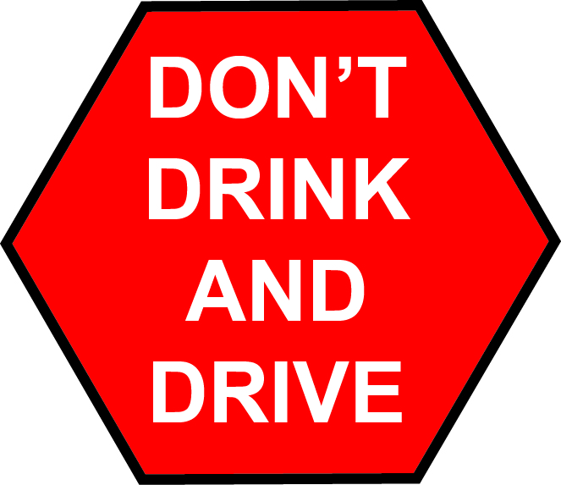
Reducing risks of drink driving
As a driver, if you plan to drink don’t drive, reduce the risk of driving by planning:
Designate a sober driver
Use public transport, eg taxi or uber
Book accommodation and stay overnight

Slide 21
Reducing risks of drink driving
After a “big night” of drinking, remember it has been proven than alcohol can stay in a person’s system for 72 hours.
If you have drank too much and must go to work, then
use public transport
If you operate any vehicle for work, eg: heavy vehicle and find you are still under the influence
Take leave or organise someone else to fill in your shift
Notes:
After a ‘big night” of drinking, don’t drive use public transport and if you drive a work vehicle organise to take leave from work. It has been proven that alcohol can stay in a person’s system up to 72 hours.
If you operate any vehicle for work, such as a heavy vehicle, and find yourself under the influence of alcohol, it is imperative that you refrain from driving to ensure the safety of yourself and others on the road. Driving under the influence not only puts lives at risk but also jeopardises your job, has legal consequences, and can impact on the reputation of your employer.

Slide 22
Reducing risks of drink driving
Reason why you should not drink and drive:
Alcohol impairs ability to drive, slows your co-ordination, judgement and reaction times
Mixing alcohol and drugs can amplify the impairing effects of each drug a person has consumed
Driving under the influence not only puts lives at risk but also jeopardises your job, has legal consequences, and can impact on the reputation of your employer
Notes:
If you operate any vehicle for work, such as a heavy vehicle, and find yourself under the influence of alcohol, it is imperative that you refrain from driving to ensure the safety of yourself and others on the road. Driving under the influence not only puts lives at risk but also jeopardises your job, has legal consequences, and can impact on the reputation of your employer.
The following is some reasons why you should not drink and drive:
Alcohol can impair the ability to drive because they slow coordination, judgment, and reaction times.
Mixing alcohol and drugs can amplify the impairing effects of each drug a person has consumed.

Slide 23
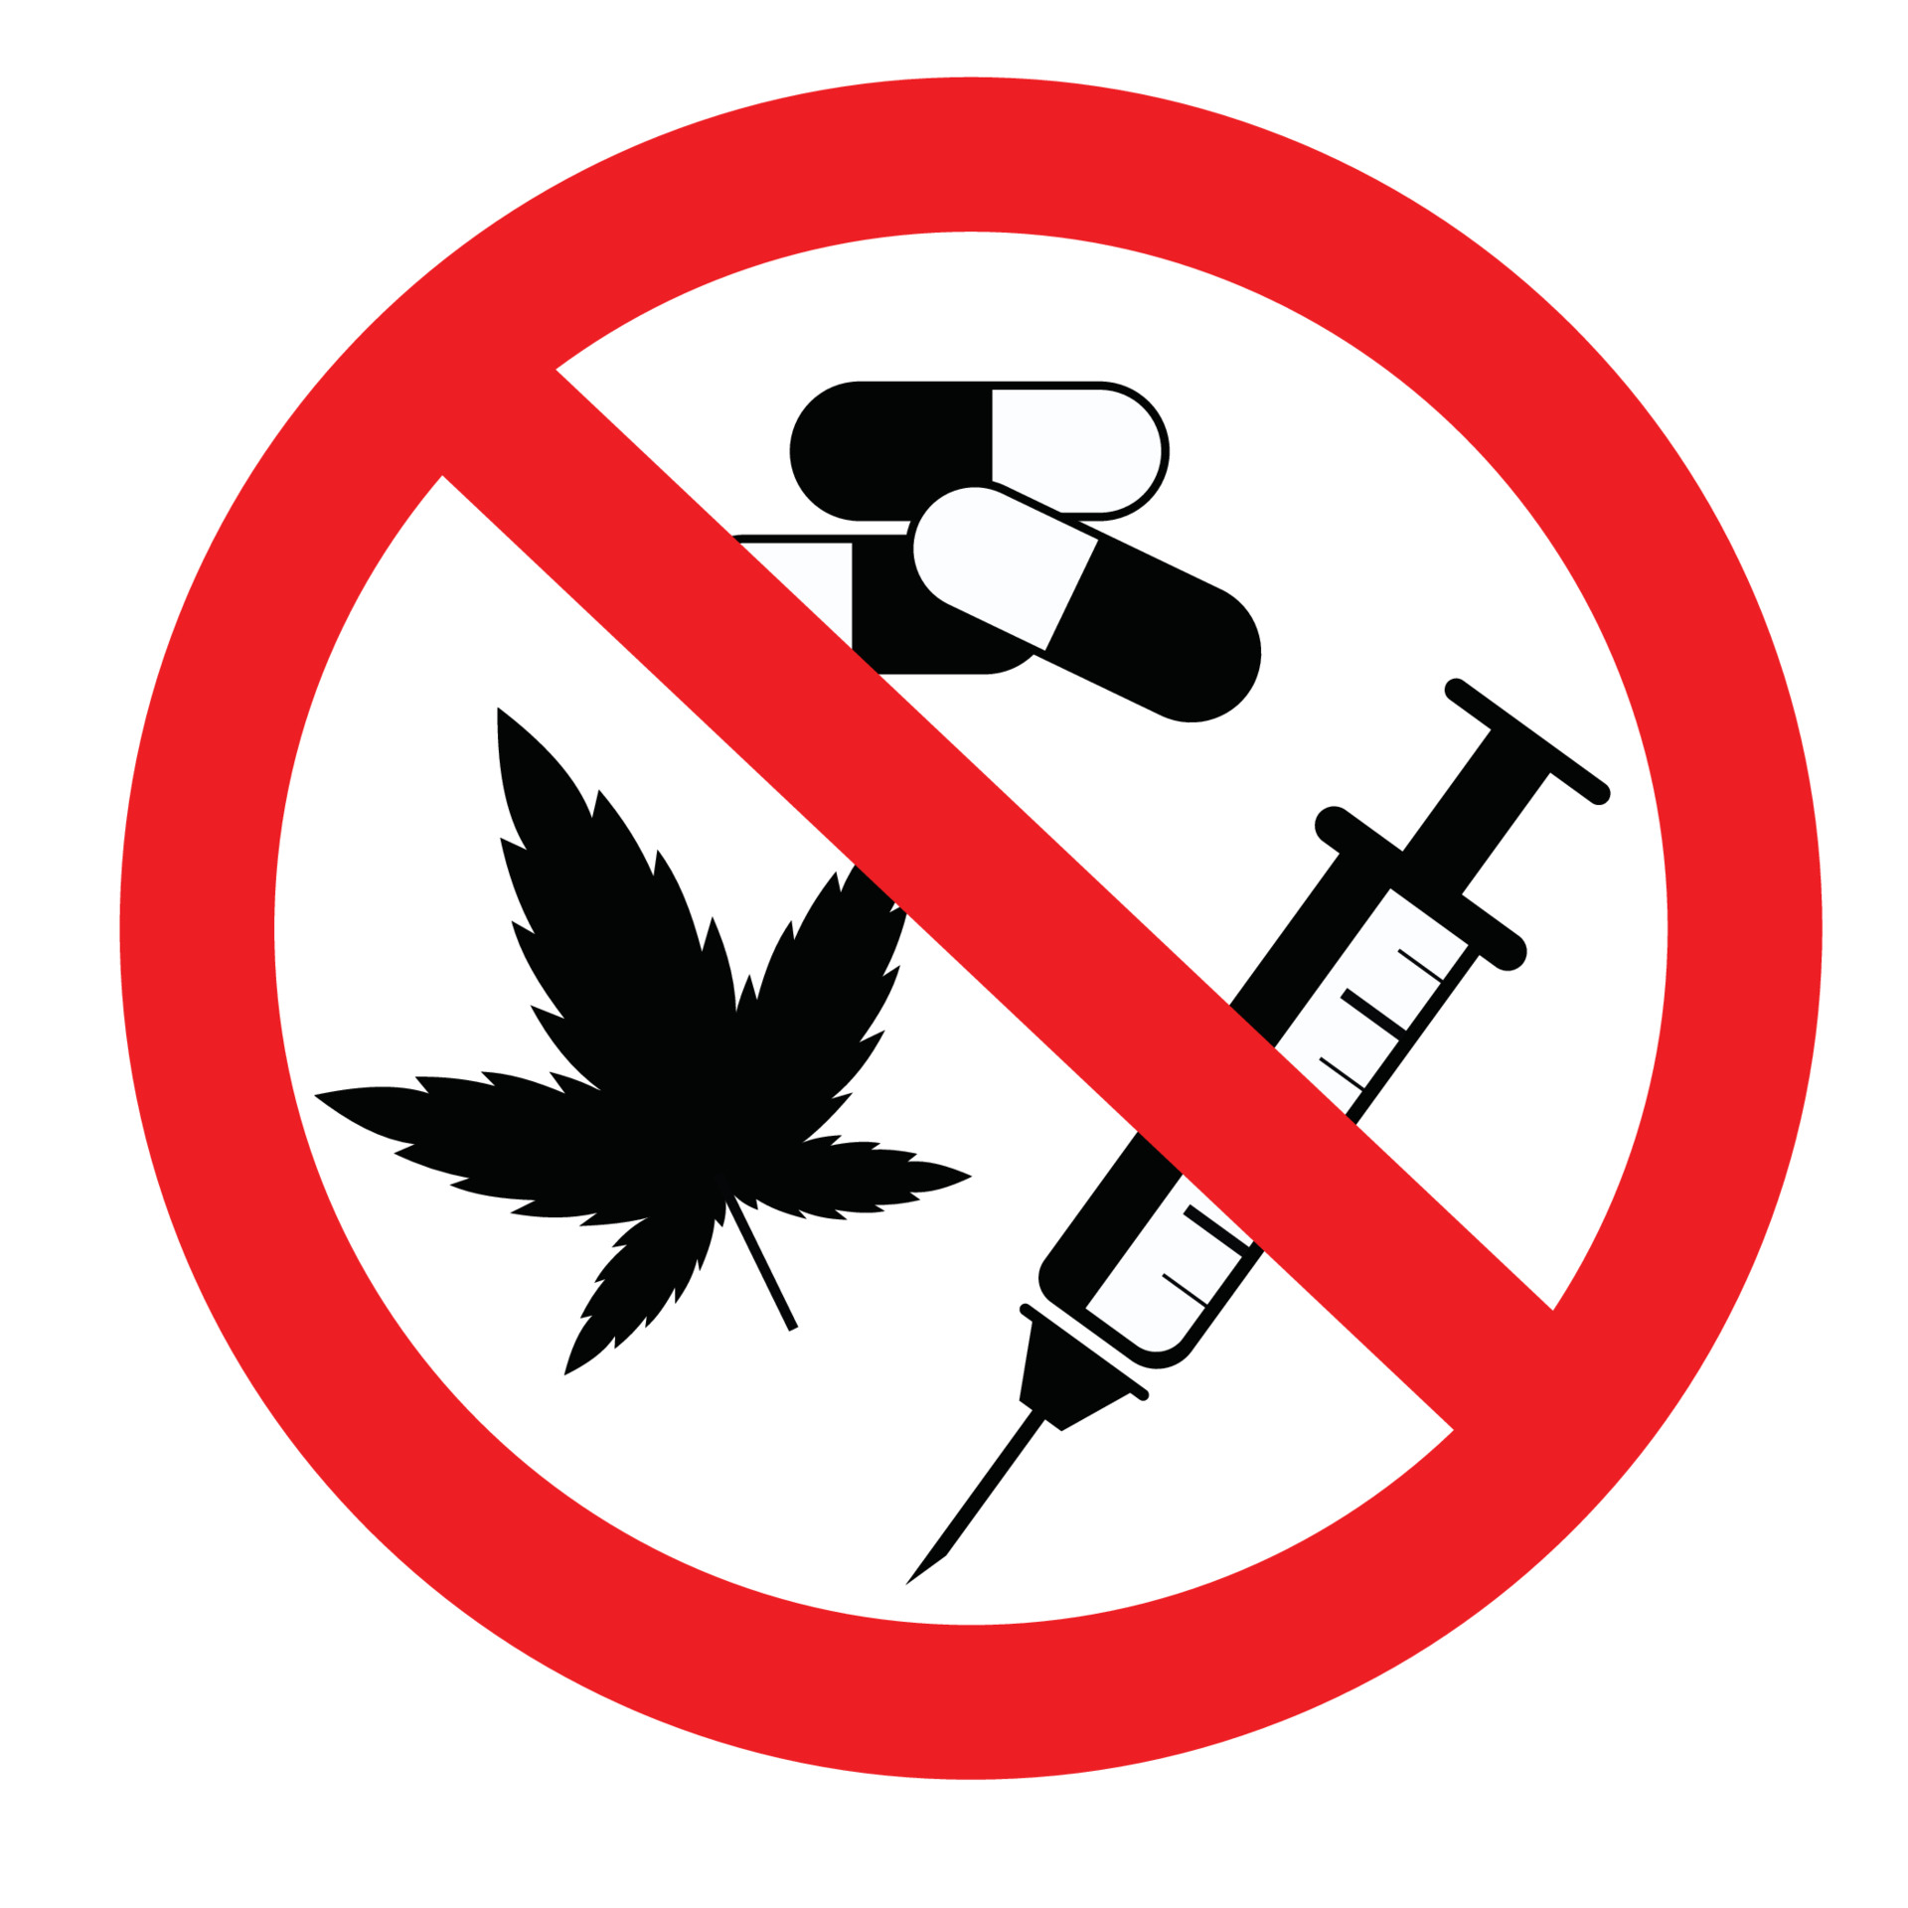
Risk of drugs and driving
Any type of drugs can impair the mental capacity of a person, whether it is prescription or OTC medicines and the misuse of illegal drugs.
Always read and follow all warning labels before driving and note the warnings against “operating heavy machinery” includes driving a vehicle.
Illegal drugs such as marijuana, ecstasy, cocaine and methamphetamine can cause different reactions that can affect driving.

Slide 24
Risk of drugs and driving
Some illegal drugs side effects are:
Marijuana (cannabis), and other drugs can impair the ability to drive because they slow coordination, judgment, and reaction times.
Cocaine and methamphetamine can make drivers more aggressive and reckless.
Using two or more drugs at the same time, including alcohol, can amplify the impairing effects of each drug a person has consumed
Notes:
Illegal drugs such as marijuana, ecstasy, cocaine and methamphetamine can cause different reactions that can affect driving:
Marijuana (cannabis), and other drugs can impair the ability to drive because they slow coordination, judgment, and reaction times.
Cocaine and methamphetamine can make drivers more aggressive and reckless.
Using two or more drugs at the same time, including alcohol, can amplify the impairing effects of each drug a person has consumed

Slide 25
Risk of drugs and driving
Even if medicinal marijuana has been prescribed by a GP, it still can impair driving and driving under its influence is an offence

Slide 26
Important to remember
Under the HVNL a person must be fit to drive a heavy vehicle, they must be physical and mentally fit to drive the vehicle and not be affected by alcohol or drugs

Slide 27
Substance abuse signs
Examples of noticeable physical signs of someone affected by substance abuse:
Glassy or bloodshot eyes
Smell of alcohol or drugs (for example, marijuana) on the breath or clothes
Slurred or incoherent speech and talking too loud or too fast
Lowered inhibitions – doing or saying inappropriate things
Impaired coordination or motor skills – poor balance and clumsiness
Notes:
xxx

Slide 28
Substance abuse signs
Examples continued:
Sense of confusion, appears lethargic or “spaced out”
Memory problems or problems concentrating
General personality changes or mood swings, irritability or outbursts additionally, for drugs: - periods of hyperactivity (“wired”), agitation or giddiness - appears fearful, anxious or paranoid.
Near miss incidents
Habitual lateness and frequent absences
Notes:
xxx

Slide 29
Addressing substance abuse
Some things a business can do to monitor and address alcohol and drug use by:
implement policies and procedures related to alcohol and drug use, eg: drug and alcohol policy
conduct regular training for employees on the risks and consequences of substance abuse
provide resources for employees seeking help with addiction, and enforce consequences for violations of the company's substance abuse policies

Slide 30
Addressing substance abuse
Con’t:
create a supportive and open environment where employees feel comfortable discussing any issues related to alcohol and drug use
conduct a fitness for work assessment that includes physical and cognitive physical activities
implementing a drug and alcohol screening program
recommend counselling and support, eg: employee assistance program

Slide 31
Addressing substance abuse
Con’t :
use your daily vehicle checklist where there is a series of questions to check the driver’s fitness to drive (see below)

Slide 32
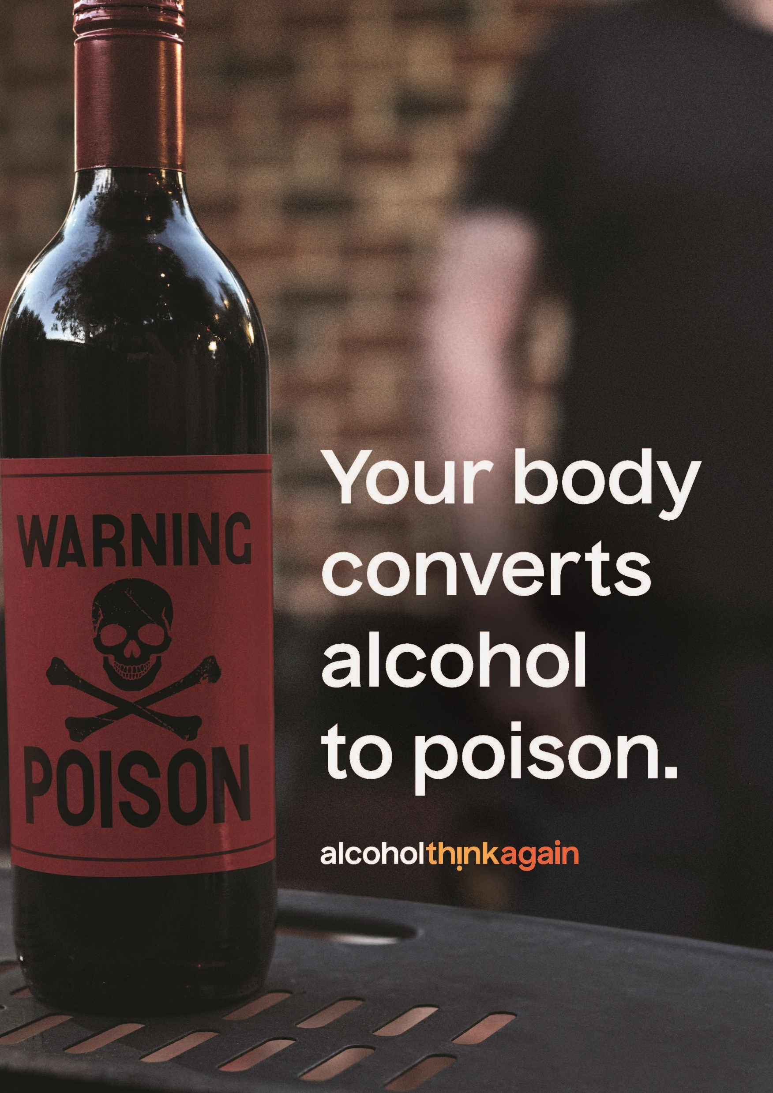
Questions
Being impaired by alcohol and drugs can be
categorised as
a hazard and poses a potential risk

