Slide 1
Toolbox Talk
REMOVALIST CUSTOMER SERVICE
TOOLBOX TALK 2024

Slide 2
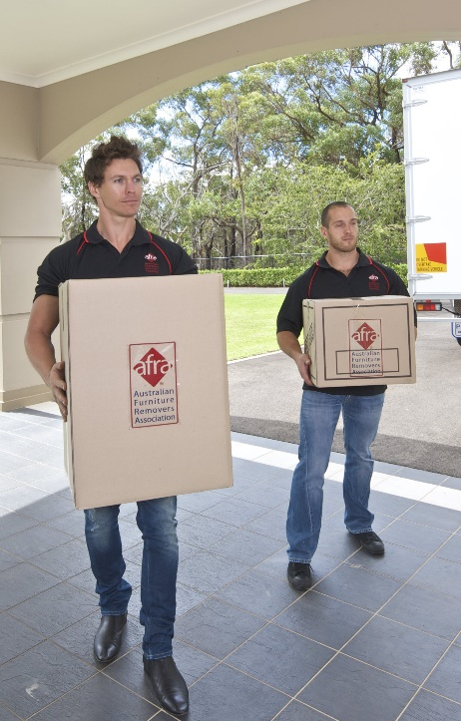
Overview
What is Customer service
Dealing with the customer

Slide 3
Think about it…
What is customer service in furniture removals?
Notes:
What is customer service in furniture removals?

Slide 4
Removals Customer Service
In the removals industry is:
support and assistance provided to a customer before, during and after the service
range of activities:
Customer satisfaction
Addressing inquiries
Resolving issues
Ensuring a positive experience
Notes:
Customer services in the removals industry is the support and assistance provided to a customer before, during and after the service.
It encompasses a range of activities aimed at enhancing customer satisfaction, addressing inquiries, resolving issues, and ensuring a positive experience

Slide 5
Removals Customer Service
Is done in different ways:
via phone – booking a move
email communications – organising the moving
in person interaction – estimator or day of service
Notes:
Effective customer service can include various ways, that is, via phone, email communication, and in-person interactions. The main goal is to build strong relationships with customers, foster loyalty, and encourage repeat business.
Some examples:
via phone – getting a quote, booking a move, discussing day and time of move
email communications – organising the moving – paperwork – quotes, confirmation of move
in person interaction – estimator gives a quote or day of service

Slide 6
Customer’s possessions
Whilst carrying out your tasks, your approach is shown by:
The goods you are handling have sentimental value to the customer
It might look like junk to you, but it may be precious to the customer
Be tactful and respect all their possessions
Notes:
The goods you are handling have sentimental value to the customer. It might look like junk to you, but it may be precious to the customer. Be tactful and respect all their possessions.
Be attentive to the customer and sensitive to their anxieties and stresses. After all, moving house is a major change in the customer's life. They will naturally be anxious about damage to their possessions.

Slide 7
Customer’s possessions
Be attentive to the customer and sensitive to their anxieties and stresses
After all, moving house is a major change in the customer's life
Customers will naturally be anxious about damage to their possessions
Notes:
Be positive and reassuring when dealing with a customer's concerns, the customer is likely to have some doubts about a stranger handling his or her property. You can help remove these doubts with a mixture of care and confidence in handling their goods.

Slide 8
Reassuring the customer by:
Listen Ask questions Be patient Be discreet Be honest Be sincere Be truthful | Be safe Emphasise the quality of your company’s services Promote prospective business Be proud of your company Sell yourself
Notes:
Here are some further things that you can do to help reassure the customer that they are dealing with a professional. If these actions are carried out, it will show respect for the customers and their personal effects; it will help dispel anxiety and make the move more pleasant for all concerned. Remember, the customer is the most important person you will deal with and your actions as your company's representative must be of a high, professional standard.
Listen
Ask questions
Be patient
Be discreet
Be honest
Be sincereBe truthful
Be safe
Emphasise the quality of your company's services
Promote prospective business
Be proud of your company
Sell yourself

Slide 9
Advising customers
Of the steps involved in the removal process
Customer will ask some questions and have concerns
Answer their questions, they are entitled to know the removal process
Best practice is to go through the move process with the customer, reconfirming what is to be moved and the work to be undertaken
Notes:
Furniture removalists must be able to advise customers of the steps involved in the removal process. The customer is likely to have some questions and concerns about the removals process and how it will affect them; you should be able to answer their questions.
The customer is entitled to know what the removal process will be. It would be best practice to go through the move with the customer, reconfirming what is to be moved and work to be undertaken.

Slide 10
Advising customers
Many of the problems that occur are often defended by questions, such as...
"Why wasn't I told about that?" or "I didn't know I couldn't claim for a breakage if I packed the carton" or "I just assumed that you would take the gas cylinder for the BBQ"
Notes:
Many of the problems that occur with moves are often defended by the question....
"Why wasn't I told about that?" OR "I didn't know I couldn't claim for a breakage if I packed the carton" OR "I just assumed that you would take the gas cylinder for the BBQ"
This confusion could all be avoided through communication.

Slide 11
Advising customers
This confusion could all be avoided through communication
Customer should be aware of his or her responsibilities
Should have been advised at time of quote, eg: explained by person organising quote, information booklet or brochure
Notes:
The customer should be aware of his or her responsibilities
Some companies use information booklets or brochures to inform their customers of their responsibilities. If these are adhered to, your job will be simple and straightforward.

Slide 12
Handling problems
"You can please some of the people all of the time, you can please all of the people some of the time, but you can’t please all of the people all of the time" - John Lydgate
Notes:
As the old saying goes:
"You can please some of the people all of the time, you can please all of the people some of the time, but you can’t please all of the people all of the time" - John Lydgate

Slide 13
Handling problems
No matter how good the service is or how hard you try to provide high standards, there will still be complaints
It is how you handle these complaints that matters most
Complaints that are not handled quickly can escalate into major issues
Some of the issues maybe because the customer is stressed
Notes:
No matter how good your service is or how hard you try to provide high standards, there will still be complaints from customers; it is how you handle these complaints that matters most.
If customer complaints are not handled quickly and effectively, an ongoing relationship with that customer can be damaged and will be difficult to recover. Some of the issues maybe because the customer is stressed about moving:

Slide 14
Customer Stress
Customer problems can arise if removalists fail to recognise customer difficulties
Recognising symptoms of stress and practicing empathy can help avoid major conflicts
Angry customers may express discomfort openly or remain quietly angry and impatient
Some signs of passive anger are less obvious but equally important to identify
Failing to recognise hidden anger can lead to loss of business
Notes:
Customer problems may arise when the removalist does not recognise that the customer is experiencing difficulties.
So, by recognising symptoms of stress and practicing effective people skills such as empathy, major conflicts can often be avoided.
On occasions, angry customers will show their discomfort and anger, but most often people can be passively, or quietly angry or impatient.
Some of these clues are more obvious than others and it is important to realise that people can be simmering with anger, without being obviously angry.
The aggressive ones are easy to recognise. But if you do not recognise the passive ones who keep their feelings hidden, you can unknowingly lose business.

Slide 15
Handling Stress
Be alert to customer signals of impatience to respond appropriately
Greet customers sensitively to prevent aggressive reactions
Focus on preventing problems through effective communication
Use careful questioning, active listening, and seek feedback to minimise misunderstandings
Acknowledge that not all conflicts can be avoided; you can only control your own responses

Slide 16
Handling Stress
Be prepared to handle customers who are confused, upset, or aggressive
As a professional, prioritise problem-solving and maintaining positive customer relations
Tips to prevent issues:
Put yourself in the customer's shoes
Think about the customer's feelings
Dealing with the customer's problems
Notes:
Here are some other ideas to help you avoid problems and handle them correctly when they do occur.
Put yourself in the customer's shoes
Dealing with the customer's feelings - Acknowledge and address the customer's feelings
Dealing with the customer's problems - Focus on how you can reduce the customer's problems

Slide 17
Right attitude for a problem
Listen sympathetically to the customer
Show your understanding
Mutually agree on a solution
Follow through and follow up
Learn from your mistakes
Handle a serious complaint promptly
How to handle unreasonable customers
Notes:
Interestingly, the reasons for liking or disliking a company rarely have to do with the product or price. The good or bad experience is almost directly related to an experience with people, either their attitude or their service.
So, what is the right attitude to have even when there's a problem? Simply follow these steps.
Listen sympathetically to the customer
Show your understanding
Mutually agree on a solution
Follow through and follow up
Learn from your mistakes
Handle a serious complaint promptly
How to handle unreasonable customers

Slide 18
Paperwork
It is important that documentation must be completed:
Protect the customer and removal company, should anything go wrong, or a claim is filled
Avoid any misunderstandings
Remember to complete:
Inventory Condition Report
Uplift docket/job sheet
Job Safety Analysis/Risk & Hazard assessment
Notes:
It is important that documentation must be completed:
Protect the customer and removal company, should anything go wrong or a claim is filled
Avoid any misunderstandings
Common removalist paperwork that is required and needs to be completed is:
Job Safety Analysis (JSA)/Risk and hazard assessments
Inventory condition report
Uplift docket/job sheet

Slide 19
Remember
Customer satisfaction plays a major role in the success of any business. When customers are happy, they return. They spread positive word-of-mouth to family and friends. Consequently, this enhances a company's reputation.

Slide 20
Questions

