Slide 1
Toolbox Talk
Safety in & around the Warehouse/Depot
TOOLBOX TALK 2024

Slide 2
Overview
Common safety risks and hazards to be aware of around a warehouse/loading dock
What everyone needs to do to prevent incidents and accidents

Slide 3
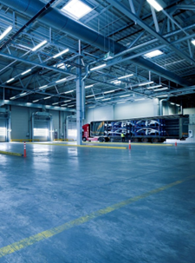
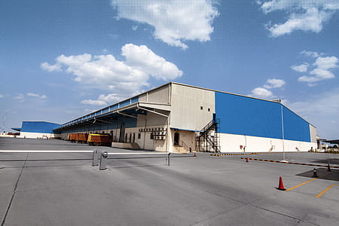
Warehouse Safety
Safety in the warehouse is very important.
It is crucial that you are aware of your surroundings while working or accessing the warehouse for any reason.
Notes:
Let us review some of the common issues that you may encounter in your warehouse.

Slide 4
Loading Dock & Warehouse
Common safety risks and hazards in and around loading docks are:
moving vehicles (eg: trucks and forklifts)
objects
pallets
boxes
equipment
items falling
obstructions

Slide 5
Employees, drivers & pedestrians
Before entering a warehouse make sure you are wearing appropriate PPE, including hi-vis vests
Wear closed in shoes
Always keep an eye on your walking or driving path to avoid collisions
Slow down and stop at the end of aisles or corners and check for any approaching forklifts etc. to prevent an incident or accident

Slide 6
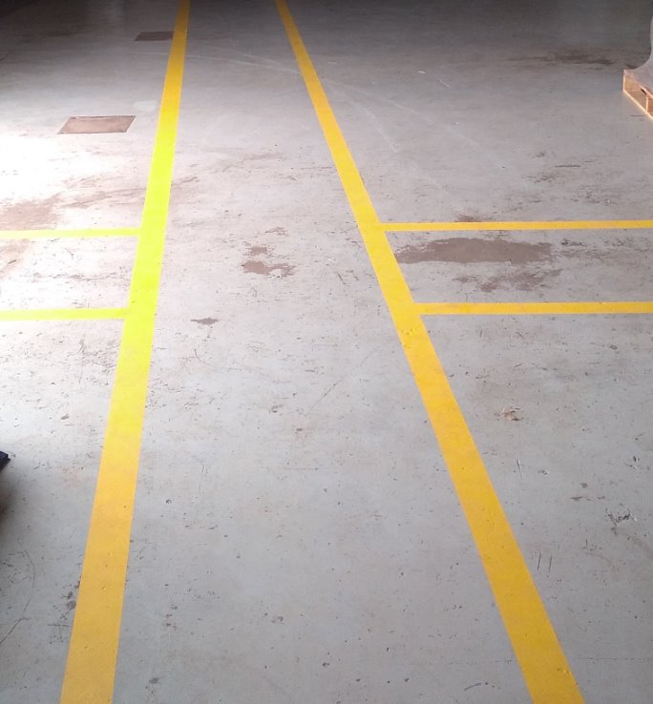
Employees, drivers & pedestrians
Keep within designated pedestrian walkways (typically marked yellow lines)
Never walk underneath a forklift when their tynes are raised

Slide 7
Warehouse employees
Dispose of rubbish, broken pallets and other debris immediately to prevent trip hazards
Ensure there is no obstruction to pathways or loading dock
General housekeeping
Vehicle drivers follow the speed limits and follow safety signs when entering the loading dock
When stacking items, place heavy items at the bottom and lighter items on top

Slide 8
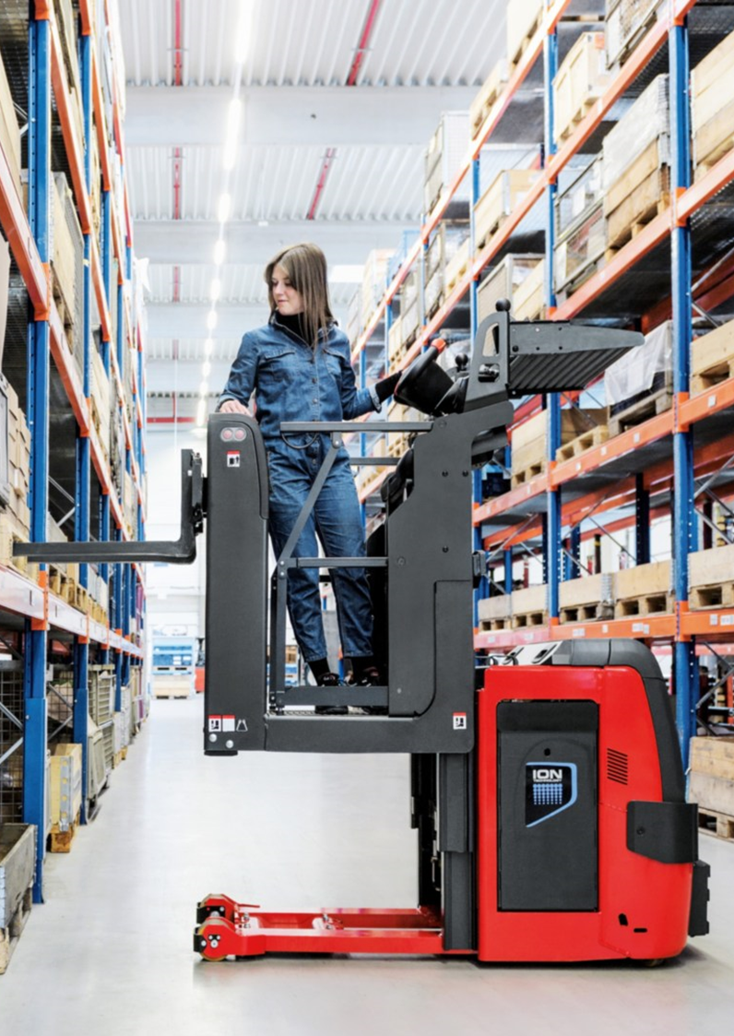
Warehouse employees
Avoid climbing or walking over pallets or racking
Do not stand on pallets or forklifts tynes to access heights
Use ladders for taking items at height to avoid falling and accidents
Always use correct lifting techniques
If an object is too heavy use lifting equipment or request assistance to do a team lift
Spillage – immediately cordon off the area and clean up to prevent slips and falls

Slide 9
Forklift drivers
Only drive a forklift if you have a valid licence
When driving a forklift always be alert
When nearing corners slow down or use a horn to signal your presence
When reversing ensure you check mirrors or ask someone to be spotter

Slide 10
Employers, supervisors etc.
Ensure all safety signage is visible and not damaged (eg: Exit, Forklift etc.)
Consider having mirrors fitted near corners or intersections to prevent collision
Place anti-slip mats in areas prone to slipping
Ensure warehouse flooring is not damaged or uneven
Regularly check and confirm all equipment is in good operating condition, eg: forklifts, lift pallets

Slide 11
Employers, supervisors etc.
Ensure that emergency evacuation maps are placed in a prominent position in the warehouse
Annual fire evacuation drills are carried out annually with designated fire wardens
First aid kits are accessible and available
Safety data sheets (SDS) are available for any hazardous chemicals etc. stored on site.
Hazardous materials are correctly stored, eg: LPG cylinders in cages to avoid risk of being hit by a moving vehicle

Slide 12
Employers, supervisors etc.
Fire extinguishers are regularly serviced and staff are adequately trained on how to use them in case of emergency
All staff are trained on how to use equipment properly
An annual fire evacuation drill is conducted to ensure that everyone is aware of how to respond in the event of a sudden fire

Slide 13
Remember
Be aware of all movement when working or accessing the loading dock and warehouse
Safety is important to avoid accidents and incidents

Slide 14
Questions

